Slide 1
IP Routing

Slide 2
Routing protocols - Routers use routing protocols to dynamically
find all networks within the greater internetwork and to ensure that all routers have
the same routing table. Routing protocols are also employed to determine the best path a
packet should take through an internetwork to get to its destination most efficiently. RIP,
RIPv2, EIGRP, and OSPF are great examples of the most common routing protocols.
Routed protocols - can be used to send user data
(packets) through the established enterprise. Routed protocols are assigned to an interface
and determine the method of packet delivery. Examples of routed protocols are IP and IPv6.

Slide 3
Routing Basics
Routers don’t really care about hosts— they only care about networks and the best path to each one of them.
Routers need following information to route packets to destination network:
Destination address
Neighbour routers from which it can learn about remote networks
Possible routes to all remote networks
The best route to each remote network
How to maintain and verify routing information

Slide 4
Router knows about directly connected routers
If network is not directly connected then the router must use one of two
ways to learn how to get to the remote network - Static and Dynamic Routing
The static routing method requires someone to hand-type all network locations into the routing table, which can be a pretty daunting task when used on all but the smallest of networks!
In dynamic routing , a protocol on one router communicates with the
same protocol running on neighbouring routers. The routers then update each other about all
the networks they know about and place this information into the routing table. If a change
occurs in the network, the dynamic routing protocols automatically inform all routers about
the event.

Slide 5
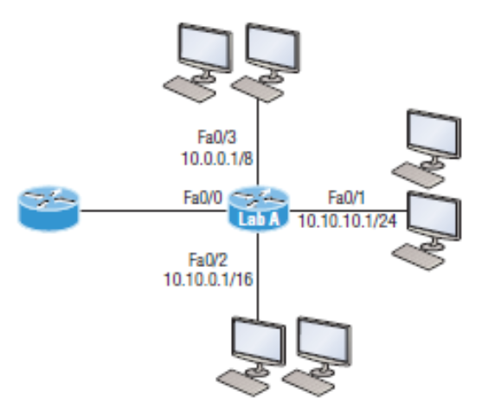
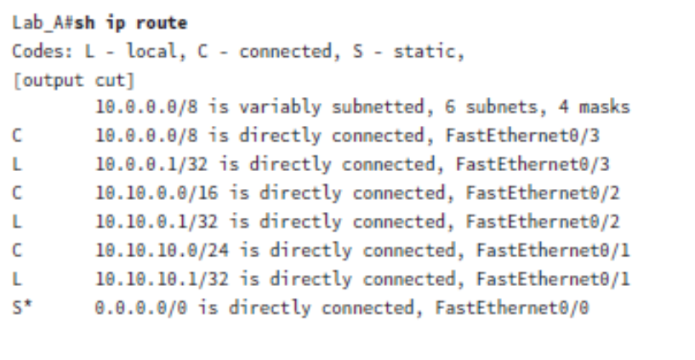
A routing example

Slide 6
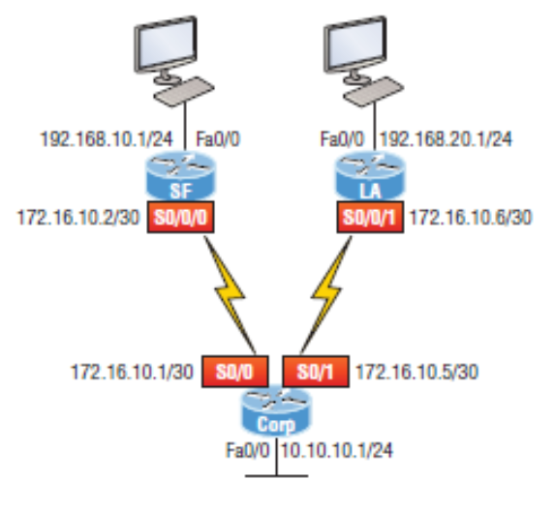
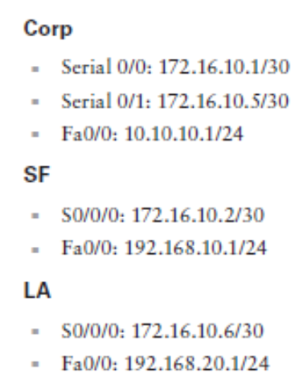
Configuring IP routing

Slide 7
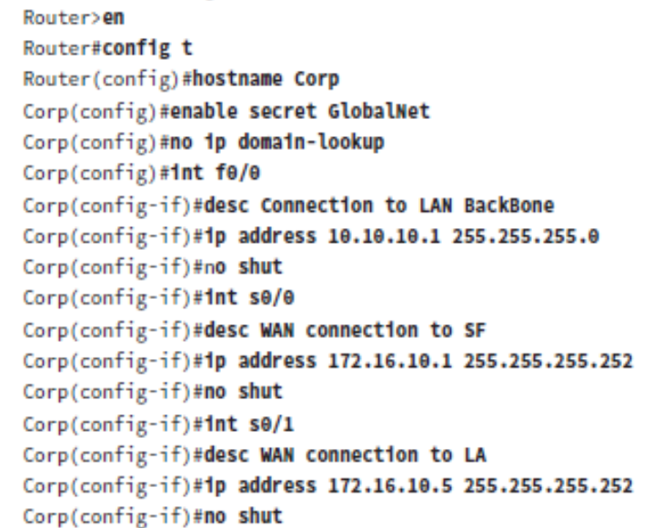

Slide 8
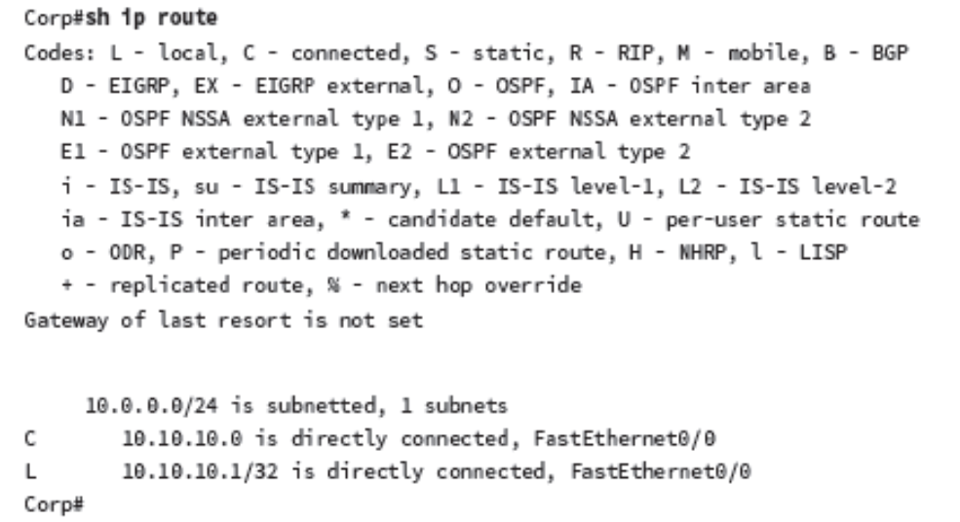

Slide 9
Static Routing
ip route [destination_network] [mask] [next-hop_address or
exitinterface] [administrative_distance] [permanent]
Router(config)#ip route 172.16.3.0 255.255.255.0 192.168.2.4 150
The ip route command tells us simply that it’s a static route.
172.16.3.0 is the remote network we want to send packets to.
255.255.255.0 is the mask of the remote network.
192.168.2.4 is the next hop, or router, that packets will be sent to.
the AD is the trustworthiness of a route, where 0 is best and 255 is worst

Slide 10
Configure static routing for the given network diagram

Slide 11
Default Routing
A stub indicates that the networks in this design have only one way out to reach all other
networks, which means that instead of creating multiple static routes, we can just use a
single default route.
This default route is used by IP to forward any packet with a destination
not found In the routing table, which is why it is also called a gateway of last resort.
LA(config)#ip route 0.0.0.0 0.0.0.0 172.16.10.5
LA(config)#do sho ip route

